Slide 1
Gym DATABASE MANAGEMENT SYSTEM
Shwet Jain

Slide 2

PROBLEM?
Everything in the Gym currently is Paper-based.
who likes Manual?

Slide 3

SOLUTION!
Design a Database
where everything from
Member/Employee Details
to
Membership
to
Order Placement
to
Plan details, Offer details, Product details
is handled by it.
Automate almost Everything!

Slide 4
HOW DID I DO IT?
Tools Used: Visio, SQL Server, MS Access

Slide 5
STEP 1: START WITH IDENTIFYING YOUR ACTORS/ENTITIES

Slide 6
STEP 2: CONSTRUCT AN ERD AND ESTABLISH RELATIONSHIP

Slide 7
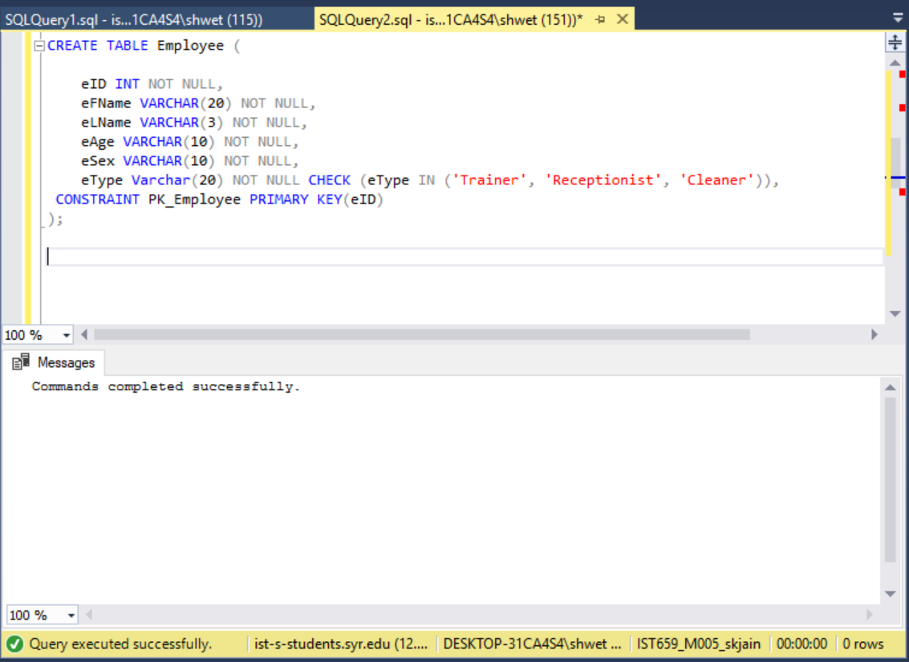
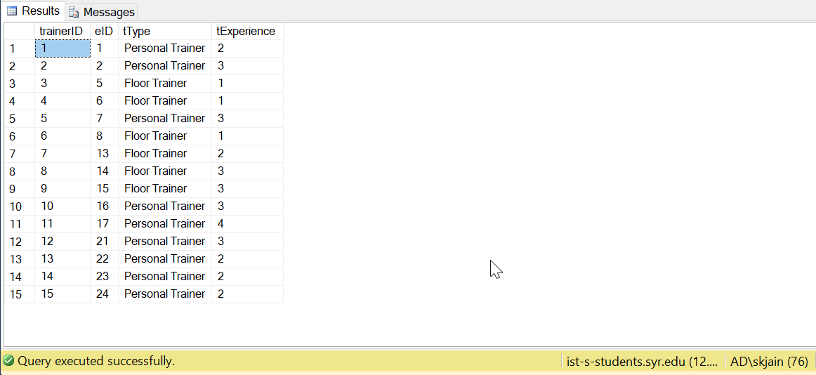
STEP 3: CONSTRUCT TABLES AND POPULATE THEM IN SQL
Note: If your X table is referring to Y table ,
Make sure you have already crated the Y table

Slide 8
YOU ARE ALL SET TO RUN YOUR QUERIES NOW!

Slide 9
Major Data Questions
1) Which member's membership is getting expired between a particular date and for which plan along with the date of expiry? Show Member ID, Member's First Name, Member’s Last Name, Plan ID, Plan Name and Expiry Date.
It is important to know when a particular member’s plan is getting expired so that we can send them a reminder for renewal of the Plan (via Member’s Ph.no)
[Customer Satisfaction and Drive Business]
2) Number of Members enrolled for a particular plan ‘Regular’ with a particular offer ‘BlackFriday’ ?
Why is this Query important and how will it impact the business?
This is a query which is useful in extracting information about a particular plan and offer.(Helpful for Data Analyst and the Gym owner to carry out analysis)
[Insights about different plans and offer which can be useful in future]
3) Create a View to find out plans a particular member has enrolled for.
Find the plans for which Member ‘Yash’ has enrolled for.
Why is this Query important and how will it impact the business?
It is possible to view different plans each member in the gym has enrolled for.
In the previous system, it was difficult and time-consuming as the system was paper-based.
[Effective, efficient system functioning]

Slide 10
4)Number of members enrolled in the gym from each Street.
Why is this Query important and how will it impact the business?
It is important to know how many members are coming from a certain Street or area. This will help us in Marketing and targeting the audience in those Streets.
[Marketing and thus improving business]
5)Created a view to find the product which was ordered the most by the members.
Why is this Query important and how will it impact the business?
This query helps us to know which is the most popular product in the gym. This is helpful for inventory purposes to make sure such products are not out of stock
[Inventory, Customer Satisfaction and Analysis]
6)Transaction (Member is enrolled for a particular plan):
Why is this Query important and how will it impact the business?
Suppose, I enrolled member X for a particular plan Y and say suppose that was a wrong entry or the entire transaction/Process of enrolling the member to a particular plan failed. It is important that we can Rollback and achieve the old/desired state.

Slide 11
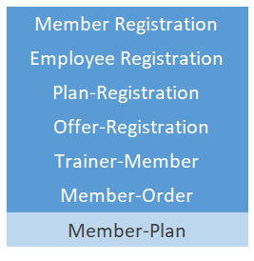
STEP 4: CREATE NAVIGATION INTERFACE

Slide 12
STEP 5: ADD FORMS & SUB-FORMS TO THE INTERFACE AS TABS

Slide 13
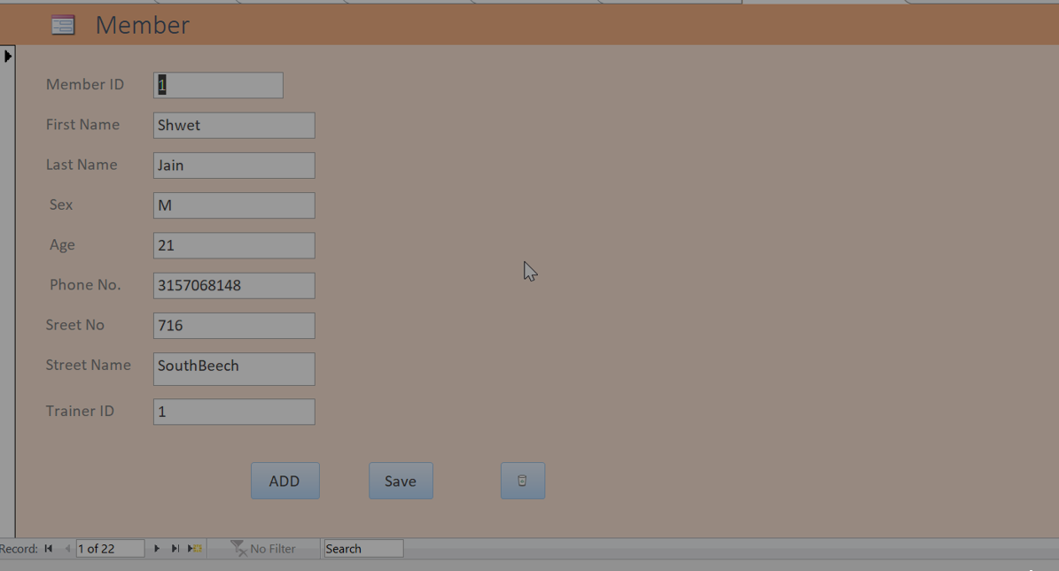
FORM 1: Member Registration

Slide 14
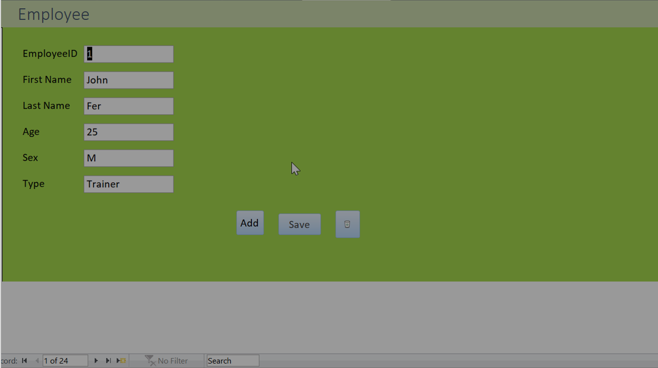
FORM 2: Employee Registration

Slide 15
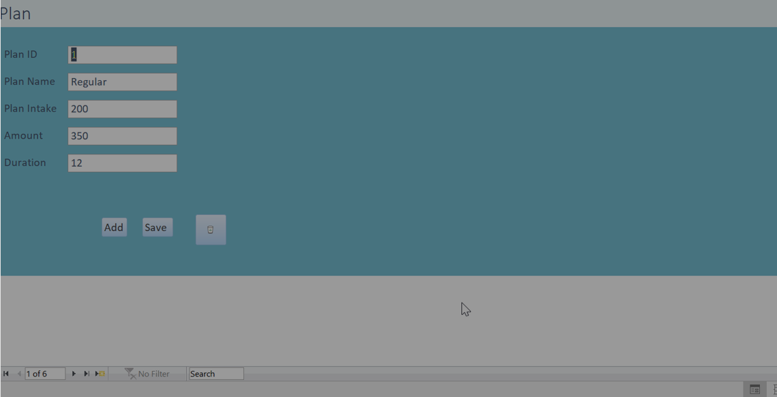
FORM 3: Plan Registration

Slide 16
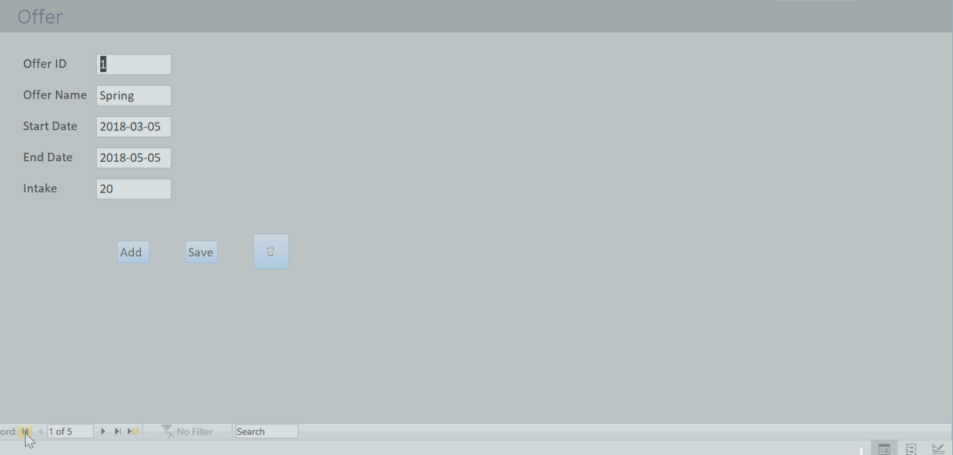
FORM 4: Offer Registration

Slide 17
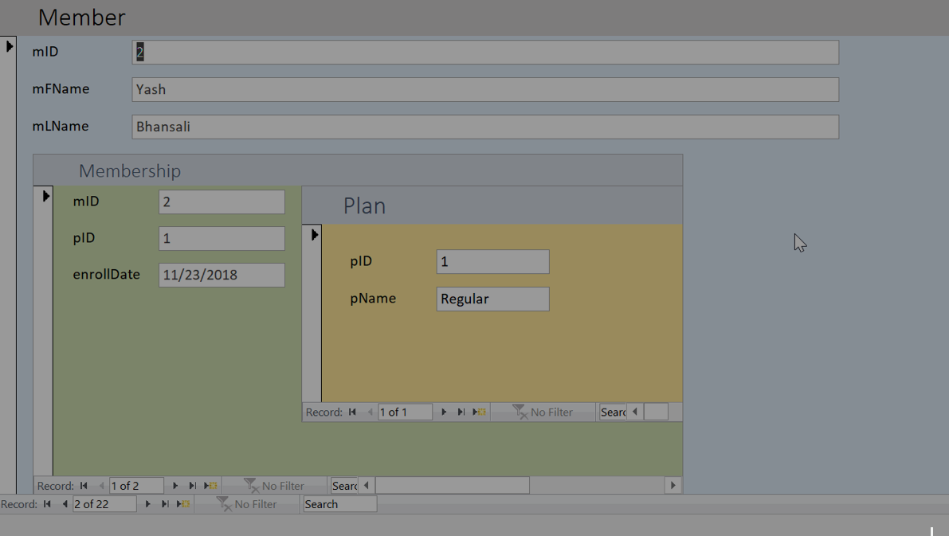
FORM 5: Member-Plan

Slide 18
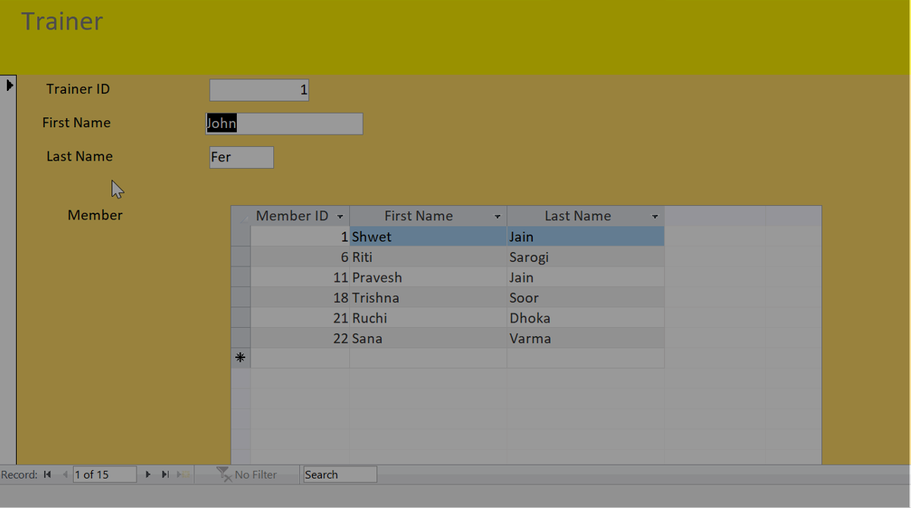
FORM 6: Trainer-Member

Slide 19
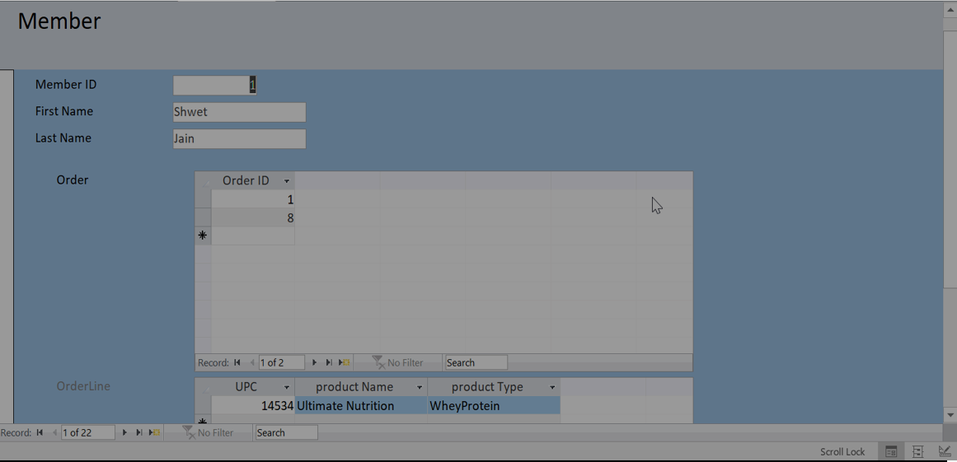
FORM 7: Member-Order

Slide 20
STEP 6: CREATE REPORTS

Slide 21
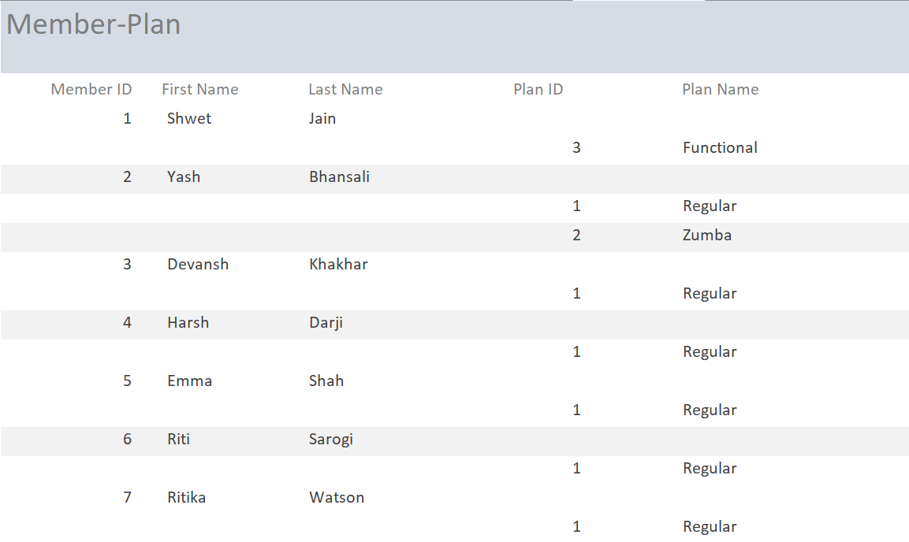
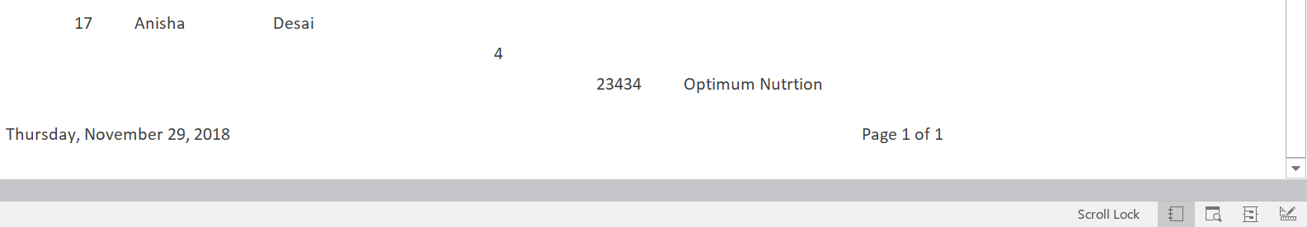
REPORT:

Slide 22
LET ME GIVE YOU A SMALL DEMO!

Slide 23
QUESTIONS?
Thank You!

